Slide 2
1.0 Project Overview

Slide 3
Project Overview: Background
•The AUVSI Robosub competition is a comprehensive system design challenge where teams from around the world design and compete in an underwater obstacle course with autonomous vehicles

Slide 4
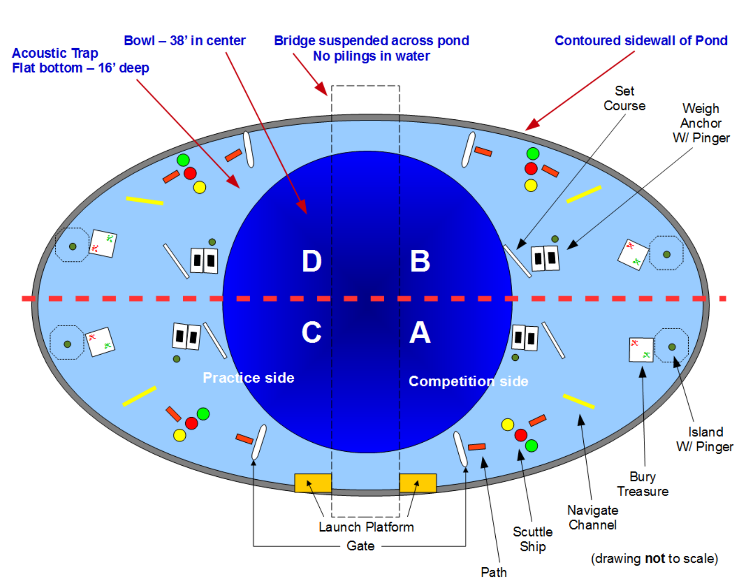
Project Overview: Background

Slide 5
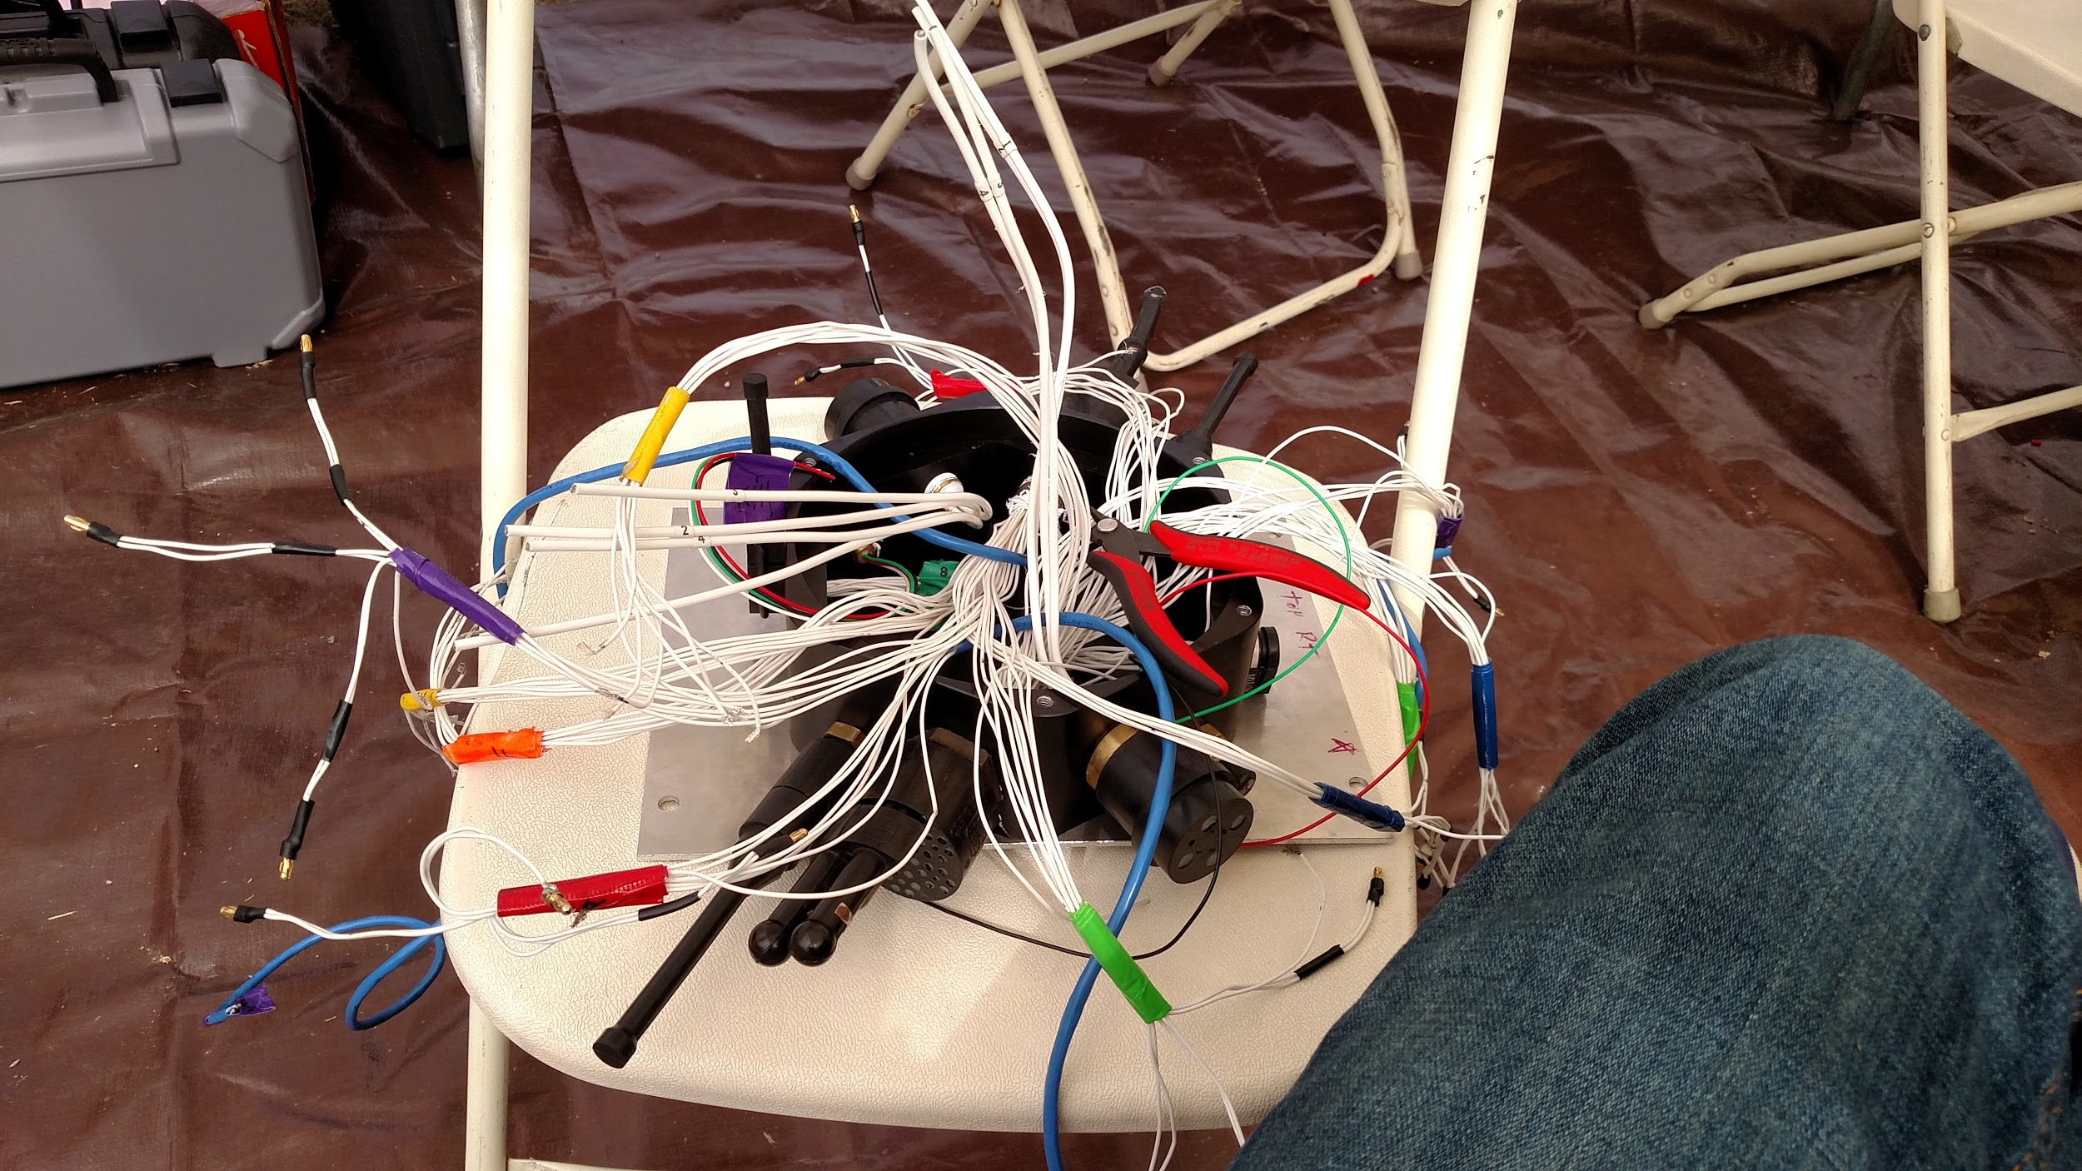
Project Overview: Background
•This senior design project hopes to eliminate problems from previous designs such as poor wire management and computer overhead

Slide 6
Project Overview: Project Statement
Develop a power system, control system, and backplane to standardize distribution of power and communication in an underwater autonomous vehicle

Slide 7
Project Overview: Objectives
•Develop a control system on a microcontroller.
–Manage 8 PWM/I2C driven motors
–Maintain stability throughout operations
–Navigate through competition tasks using time optimal paths
•Design and build power merge circuit
–200A input and current draw output for motors
• Design and build power conversion circuits
–10A 14.8V input
–3.3V, 5V, 19V, 48V output lines between 1-3A
•Design and build a backplane PCB that will provide universal connection for all modular PCBs being designed for RoboSub.
Notes:
Must be able to manage eight PWM/I2C driven ESC’s and motors in order to maintain stability during navigation and task completion at the RoboSub Competition
Develop a navigation system to calculate time optimal paths to a desired orientation and velocity in an environment with six degrees of freedom

Slide 8
Project Overview: Concept of Operation
•Main CPU will provide a vector containing desired orientation of RoboSub and desired velocities.
•Navigation system will calculate a time optimal path using the desired vector and data provided by two inertial measurement units (IMU)s and one Doppler Velocity Logger (DVL), then feed information to the control systems to maneuver appropriately.
•Power Systems will provide current and voltage requirements to all systems, including Controls, CPU, Sensors, Hydrophones, Camera, and Motor systems
•Power Systems will be shut down motor operations when the kill switch is activated

Slide 9
Project Overview: Success Criteria
Minimum Success Criteria:
•Navigation system will be able to provide time optimal paths to the control system
•PID control of all motors for stability and maneuvering
•Uninterrupted power provided to all systems while the kill switch is disabled
•Motor operations stopped when kill switch is enabled
•Backplane distributes power and communications lines throughout the vehicle

Slide 10
Project Overview: Success Criteria
Comprehensive Success Criteria:
•Navigation will be able to provide pathing information no more than one second after receiving direction
•Motors are controlled using an H₂ or H∞ control system.
•Power distribution monitoring
Extension Success Criteria:
•Controls system executes predefined mission functions
•Power can be hot-swapped to a benchtop power supply for continuous operation

Slide 11
2.0 System Overview

Slide 12
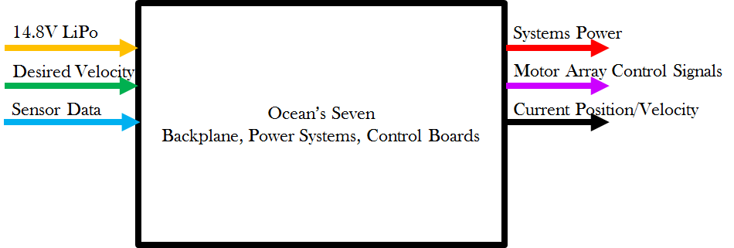
Functional Decomposition, Level 0

Slide 13
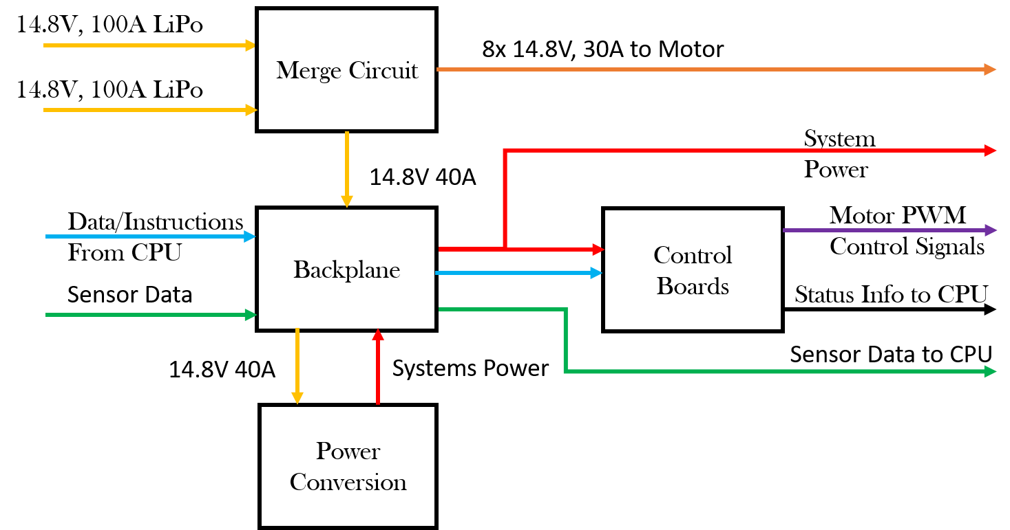
Functional Decomposition, Level 1

Slide 14
Functional Decomposition: I/O Description
Inputs
Outputs
•3kW at 14.8 Volts will be provided through a merge circuit by two lithium polymer (Li-Po) batteries in parallel
•Sensor data will include current translational and angular position, velocity, and acceleration. This will be provided by two IMUs and one DVL.
•The CPU will provide a position or velocity vector for the navigation and control systems
•Systems Power including 3.3V, 5V, 19V, 14.8V, and 48V rails
•Motor array control signals via PWM or I2C to eight electronic speed controllers
•Current position and velocity vectors sent to the CPU for decision making

Slide 15
3.0 Subsystem Design

Slide 16
Subsystem Design: Power and Backplane
Purpose of System:
To power the electrical components of the submarine to do its functions
Convert voltages and currents to meet the requirements of the motors, CPU, hydrophones and the controls system’s power specifications
Design an efficient power system with minimal heating
Design a backplane to centralize all connections in the submarine and eliminate excessive wiring
Team:
Yuvin, Kyle and Hassan

Slide 17
Subsystem Design: Power
Requirements:
Required Power Outputs:
3.3V, 2A for the microcontroller in controls system
5.0V, 2A for IMU, Hydrophones and other controls system parts
14.8V, 200A for the motors
19.0V, 4A isolated for the CPU
48.0V, 2A for the DVL and PoE for a camera
Current merge circuit to get a 200A output
Voltage and current sensing
Kill switch to turn off the motors for safety

Slide 18
Subsystem Design: Power
Notes:
Functional Decomposition - Level 2

Slide 19
Subsystem Design: Power
Specifications:
Batteries:
2 x 14.8V, 10C, 10000mAH, Multistar Li-Po
Power Outputs:
14.8V for motors: Powered directly from the batteries
3.3V: Recom R-78E3.3-1.0 Switching Regulator
5.0V: Recom R-78E5.0-1.0 Switching Regulator
19.0V: LTC3780 High Efficiency, Switching Boost Converter
48.0V: LT3958 High Efficiency, Switching Boost Converter

Slide 20
Subsystem Design: Power
Specifications:
Current merge circuit:
LTC4357 Positive High Voltage Diode Controller
Voltage and current sensing:
Current sensing: AD8217 Zero-Drift Current Shunt Monitor
Voltage sensing: Voltage dividers
MK20DX256 ARM microcontroller
Kill Switch:
Infineon OptiMOSTM Power-MOSFET, 30V IPT004N03L
Power over Ethernet:
TP-Link PoE Injector TL-POE150S

Slide 21
Subsystem Design: Backplane
Requirements:
Take in 14.8V, 10A from current merge circuit
Deliver 3.3V, 5V, 14.8V, 19V, and 48V outputs from the power board to the controls system, CPU, and sensors
Facilitate RS232 communication between controls system and the CPU
Provide I2C Communication between the controls system and ESCs

Slide 22
Subsystem Design: Backplane
Specifications:
Wire-to-board connectors
8x Motors: 4-pin, 30A 10 AWG, .250" PowerStrip™/40 A Single Row Discrete Wire Cable Assembly (Samtec)
2x Batteries: 4-pin, 100A 8 AWG, Mini-Fit Sr.™ Power Wire-to-Board Connectors (Molex)
Control system: x-pin, 3A CLIK-Mate™ Wire-to-Board Connectors (Molex)
Hydrophones: 4-pin, 1A, data
Kill Switch: 3-pin, 0.1A
Notes:
For data, as of now, it seems like we will only need 20 pins for data. However, more pins might be required in the future.
**Rated at

Slide 23
Subsystem Design: Backplane
Specifications:
Board-to-board connectors
The Power Board: x-pin, 3A
SlimStack™ Fine-Pitch SMT
Current merge board: x-pin, 10A
Control Board: x-pin, 1A, data

Slide 24
Subsystem Design: Power and Backplane
Fall 2016 Schedule
Oct.20 | Begin PCB schematic
Nov. 1 | PCB schematic review and begin Test PCB layout
Nov. 17 | PCB layout review, ordering the Test PCB and ordering parts
Nov. 19 – Nov. 27 | Fall Break
Nov. 29 | Populating the Test PCB
Dec. 1 | Testing and debugging

Slide 25
Subsystem Design: Power and Backplane
Spring 2017 Schedule
Find solutions for problems found on the testing board.
Modify schematics if necessary.
Redo the layout to fit the final product requirements.
Separate layouts for the merge circuit and power converters.
Power converters should be able to fit into the Backplane through a board-to-board connector.
Final testing before connecting to the submarine.

Slide 26
Subsystem Design: Power and Backplane
Risks | Contingency Plan
Excessive heating from the 200A trace | Minimize trace length from the current merge circuit to the ESCs
Power traces interrupting data traces | Proper trace isolations
Trace failure (due to heating, soldering, etc.) | Liquid electrical tape
Hole flooding due to a leak in the hull | Use mineral oil to fill the hull

Slide 27
Subsystem Design: Controls
Purpose of System:
Allow submarine to navigate smoothly through course
Needs to be able to handle different “move” functions
Using IMU and DVL for feedback to determine the signal that needs to be sent to motors
Team:
Abbigail, Cassandra, Daniel, Kyle

Slide 28
Controls Decomposition Level 2

Slide 29
Subsystem Design: Controls
Specifications:
STM32F767 Cortex M7 microcontroller
JTAG programmer/USB debugger/etc to communicate with the microcontroller
RS232 data lines for IMU and main cpu
Molex connector to get data/power from backplane
Serial data lines to 8 ESCs

Slide 30
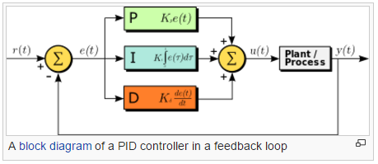
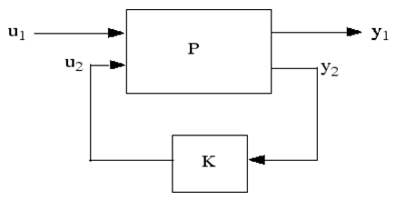
Subsystem Design: Controls
Create Model of System
Needed in order to design a controller
Preliminary Design: PID Controller
Used for initial design
Later will be used as a software backup
Next Step: Design H2 or H∞ controller
Final design
Notes:
Describe understanding necessary to create these controllers: math problem and tuning with and without Matlab

Slide 31
Subsystem Design: Controls
Controller pros and cons:
 | Pros | Cons
PID | Only needs coarse tuning for satisfactory results Math is easier | Does not provide optimal control Will lag in response to large disturbances since it is a reactive controller Doesn’t handle non-linear constraints very well
H2/H∞ | Extremely stable system Guaranteed performance | Optimization problem involves high level of mathematical understanding needed to be successful Need a very good model of the system for it to work Doesn’t handle non-linear constraints very well

Slide 32
Subsystem Design: Controls
Schedule
Now - October 28 | Create model of system Characterizing motors
October 28 - November 29 | Have a PID controller ready for proof of concept Begin initial H2/∞ controller design
November 29 - January 31 | Have controllers finalized and ready for tuning
January 31 - February 28 | Tune controllers Begin integration
February 28 - End of Class | Integration, testing, tuning

Slide 33
Subsystem Design: Controls
Risks | Contingency Plan
Possibility of mechanical team changing motor placement | Communication is key, but we would need to redesign controllers
Need actual robot in order to tune effectively, there is a possibility that we may not have the robot ready until much later | May need to design controller for old submarine system if new system will not be ready in time
Little knowledge about H2 and H∞ controllers, this will prove to be a challenging problem | This will require lots of time to learn and to get the math correct, but if it doesn’t work we will have our PID controller as a backup
Unable to purchase certain necessary sensors, we must not break the ones we already have | Send parts back to manufacturer for repair
Need to coordinate with other teams for integration, this usually causes unforeseen issues | Lots of communication and plan as much time as possible for integration
Notes:
You can read off these issues, but be sure to discuss a contingency plan for each one

Slide 34
Proof Of Concept
Requirement | Verification Method | Description
Control System will be able to maintain stable trajectories and enable maneuvering in high precision environments | Simulation | Motors will be modeled in Simulink or comparable software and will show response times
Power systems will provide stable voltage and current requirements to all systems in RoboSub | Test | Elements will be subjected to large current swings to ensure components will not fail and voltages are stable
Notes:
Main goals- to demonstrate control system(stability, maneuvering) in simulation, to test power conversion circuits

Slide 35
Proof of Concept
Controls Board v1 tested to ensure that all the relevant signals go where they need and that all connectors/power work as intended
Matlab model of PID algorithms to be implemented
Power Conversion Test Board with the merge circuit, tested for all power conversion levels
Notes:
building for PoC: controls board v1, matlab PID model, Power Conversion Test Board

Slide 36
4.0 Project Management Plan

Slide 37
PMP: Power & Backplane Budget
Item | Price ($) | Quantity | Subtotal ($)
2-layer PCB | 33 | 3 (x3 revisions) | 297
Power MOSFETs | 6 | 12 | 76
MK20DX microcontroller | 5 | 3 | 15
DC/DC converters | 6 | 12 | 72
LiPo batteries | 100 | 6 | –
Misc Parts (ICs, resistors, capacitors, connectors) | - | - | 160
Shipping | 100 | - | 100
TOTAL = $ 720

Slide 38
PMP: Controls Budget
Item | Price ($) | Quantity | Subtotal ($)
Microcontroller | 15 | 3 | 45
STM32 Development Board | 50 | 1 | 50
2-layer PCB | 33 | 1 (x3 revisions) | 198
Misc. Parts & Connectors | - | - | 30
Shipping | 40 | - | 40
TOTAL = $ 363

Slide 39
PMP: Overall Budget
Item | Subtotal ($)
Power & Backplane Subsystems | 720
Controls Subsystem | 363
Misc. Parts & Connectors | 60
TOTAL = $ 1143

Slide 40
PMP: Division of Labor
Kyle (Power and Controls) | Project Co-Lead, Robosub Liaison, Design Point Person, Merge Circuit Board Design
Cassandra (Controls) | Project Co-Lead, Chief Administrator, Controls Board Design, Controls Algorithms
Abby (Controls) | Controls Board Design, Controls Algorithms, Motor SysID
Daniel (Controls) | Budgeteer, Controls Board Design, Controller Software, Manage Ordering Materials for Controls
Hasan (Power) | Backplane Design, Order Power PCBs
Yuvin (Power) | Converter Board Design, Manage Ordering Power Parts

Slide 41
Questions?

